Slide 1

Determining the Economic Impacts of Advancing Whole Health
An Experiential Workshop
Patricia M. Herman, ND, PhD
Senior Behavioral Scientist
Assisted by Brian Anderson, DC, MPH, MS, PhD
Palmer College of Chiropractic

Slide 2
For integrative health approaches to be a viable part of healthcare they must be economically feasible as well as safe and effective.
This workshop uses a combination of lecture and exercises to give participants a strong foundation in economic evaluation in general, and cost-effectiveness and cost-utility analyses specifically.

Slide 3
Overview
Objective 1: Basic principles and different types of economic evaluations and the importance of the perspective
Whole group exercise: Examples of economic studies
Objective 2: Identify and prepare appropriate effectiveness data
Individual exercise: Measures of effectiveness to consider
Objective 3: Available sources of cost data and the impact of the perspective
Small group exercise: Calculate cost-effectiveness for some examples

Slide 4
Effectiveness and costs of four therapies compared to usual care
If a decision maker had to choose a therapy and this was the only information they had, which one would they choose?

Slide 5
Effectiveness and costs of four therapies compared to usual care
$1050
$80
If that same decision maker now had this information, which therapy would they choose?
-$100
$100

Slide 6
Why Do an Economic Evaluation?
Adds important information for decision makers for:
  Coverage decisions
  Licensure decisions
  Investment decisions
Complementary and integrative medicine is often considered only as an “add on” cost
Increasing relevance for health policy decision making as healthcare costs rise
If patient is paying out-of-pocket it is unethical to not consider their cost of care

Slide 7
Cost-Effectiveness Decision Matrix
Increased Costs | Definitely Reject Alternative (Base Case Dominates) |  | Decision: Are benefits worth the costs?
No Change |  | Indifferent
Cost Savings | Decision: Is health loss worth the savings? |  | Definitely Adopt Alternative (Alternative Dominates)
 | Worse Health No Change Improved Health

Slide 8
Measure of Health Determines the Type of Economic Evaluation
Basic equation: (Cost₂ – Cost₁) / (Health benefit₂ – Health benefit₁)
Type of Economic Evaluation | Measure of Health Used
Cost-Benefit Analysis (CBA) | Monetary value of health
Cost-Effectiveness Analysis (CEA) | Naturalistic units – e.g., mmHg of BP, years of life saved
Cost-Utility Analysis (CUA) | Utility (preference) measure – e.g., quality-adjusted life years (QALYs)
Cost-Minimization Analysis (CMA) | Health impacts explicitly assumed to be equal
Cost-Consequence Analysis | All relevant measures of health
Cost Comparison or Cost Analysis | No measure of health impacts

Slide 9
Cost-Effectiveness Decision Matrix
Increased Costs | Definitely Reject Alternative (Base Case Dominates) |  | Decision: Are benefits worth the costs?
No Change |  | Indifferent
Cost Savings | Decision: Is health loss worth the savings? |  | Definitely Adopt Alternative (Alternative Dominates)
 | Worse Health No Change Improved Health

Slide 10



Costs Depend on the Perspective
Possible perspectives:
Individual or Patient
Institutional (e.g., third-party payer*, hospital, employer)
Societal*
Who are the decision makers you are trying to influence?
  This determines the perspective(s) to use
  [Societal used for government decisions]
*Perspectives most commonly used
AdobeStock
Fotolia
Fotolia

Slide 11
Cost-Effectiveness Decision Matrix
Increased Costs | Definitely Reject Alternative (Base Case Dominates) |  | Decision: Are benefits worth the costs?
No Change |  | Indifferent
Cost Savings | Decision: Is health loss worth the savings? |  | Definitely Adopt Alternative (Alternative Dominates)
 | Worse Health No Change Improved Health

Slide 12
Four Basic Principles of Economic Evaluation
It is a decision-making tool
  Adds another dimension of information
  Realistic comparisons
  Timeliness and relevance
Incremental analysis
  Additional costs compared to additional benefits
The type of economic evaluation is determined by the health benefits
The perspective of the analysis determines the costs to include
  Perspective should match decision maker you are trying to influence

Slide 13
Exercise 1: Group Evaluation of Published Abstracts
For each example abstract:
What was being compared?
  Would this be considered a whole person health intervention?
  Is the comparator appropriate for economic evaluation?
What is the measure of health impacts used in the study?
  Would that be a measure of whole person health?
  What type of an economic evaluation is this?
What is the perspective of analysis?
  What source was used to obtain costs?
  What type of decision maker is this study targeting?
Within which quadrant do the results reside?

Slide 14
Objective 2: Identify and apply an appropriate measure of effectiveness

Slide 15
Cost-Benefit Analysis – Monetary Health Benefits
Costs₂
Benefit₂
Minus
Minus
Costs₁
Benefit₁
Monetary Units
Monetary Units
e.g.
Costs of medication
Costs of care
Cost of intervention
e.g.
Dollar value of an improvement in health; often estimated using willingness-to-pay methods
Big challenge for CBA: determining a monetary value for the impact on health

Slide 16
Cost-Effectiveness Analysis – Naturalistic Unit Health Benefits
Costs₂
Effectiveness₂
Minus
Minus
Costs₁
Effectiveness₁
Monetary Units
Naturalistic Units
e.g..
Lowering of blood pressure in Hg
Proportion of patients improved
This ratio is called an Incremental Cost-Effectiveness Ratio (ICER)
Note: ratio only calculated if denominator and numerator are both positive
Big challenge for CEA: comparing across interventions targeting different outcomes or conditions

Slide 17
Cost-Effectiveness Analysis – Potential measures of effectiveness
Number of persons saved
Saved life-years
Number successfully treated or diseases prevented
Reduced frequency, duration, or intensity of symptoms
Workdays gained
Other clinical outcomes (e.g., mmHg blood pressure lowered, % lowering cholesterol below a threshold)

Slide 18
Cost-Utility Analysis – Naturalistic Utility-Based Benefits
Cost₂
QALY₂
Minus
Minus
Cost₁
QALY₁
Monetary units
Naturalistic but utility-based units
Quality of life (morbidity)
Qualitative measures (utility)
QALYs
Quality-Adjusted Life-Years
Life expectancy (mortality)
Quantitative measure (time)
⇒ Cost per QALY (ICER)

Slide 19
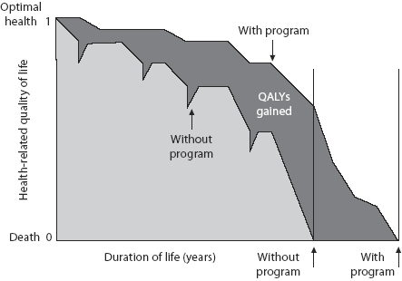
Cost-Utility Analysis – Quality-Adjusted Life-Years (QALYs)
Note that the measure of QALYs gained is an area. It is the difference between two trajectories over time.
(HRQoL or Utility)

Slide 20
Cost-Utility Analysis – Quality-Adjusted Life-Years (QALYs)
If only looking over one year (often true in studies of CIH):
This area is the gain in QALYs for the year. Calculated as:
(0.7 – 0.6)/2 = 0.05
Optimal health 1.0
With intervention HRQoL improved to 0.7 after one year.
0.7 +
0.6 +
Health related quality of life (HRQoL or Utility)
Assume that HRQoL would stay constant without intervention
Note that if you have more than one measure of HRQoL over the year, QALY gain is the area between the line connecting those points and the flat baseline line.
Death 0.0
Ι
1 Year
Time

Slide 21
Measuring Quality-Adjusted Life-Years (QALYs)
Use quality of life questionnaires for which preference weights exist
SF-6D (calculated from SF-36, SF-12)
EQ-5D
PROPr (calculated from PROMIS-29 +2)
Other estimates have been made from:
  WOMAC
  Oswestry Disability Index
  Roland Morris Questionnaire

Slide 22
Exercise 2: Individual Exercise Calculating QALYs
Use worksheet to calculate your current health-related quality of life index (utility) from your EQ-5D-5L (or SF6D) responses
Assuming 1 year ago your utility was at 0.7, calculate your quality-adjusted life-year (QALY) gain this year.

Slide 23
Objective 3: Available sources of cost data and the impact of the perspective

Slide 24
The Costs to Include are Determined by the Perspective of the Analysis
Types of Costs | Patient | Payer | Hospital | Employer | Society
Direct medical costs* Practitioner fees Diagnostic costs Treatment (drug) costs Facilities and equipment Ancillary staff | What the patient pays out of pocket | What insurance covers | The cost to the hospital of providing these | What the employer covers | All these costs
Direct nonmedical costs Transportation costs Time off work for appt Childcare | Costs the patient incurs |  |  |  | All these costs
Indirect costs Lost work productivity |  |  |  | Lost employee productivity | All these costs

Slide 25
General Information on Cost Data
Terminology:
Costs = # Resources Used * Unit Cost of Resource
Sometimes you can find actual costs (e.g., claims data with dollar amounts reimbursed included), but more often you measure resources used and multiply them by their unit costs.
Decision: Overall costs or Disease-specific costs?
Overall costs = all costs independent of disease
Useful to capture full benefits of CIH since these therapies can often improve health and lower healthcare use beyond targeted disease
Disease-specific costs = only costs related to the disease studied
Easier for patients to report if depending on questionnaires for cost data

Slide 26
Sources of Cost Data
Ideally use data from sources your decision maker uses and trusts:
  Payer – healthcare claims data (e.g., Medicare, Medicaid)
  Employer – healthcare claims they cover
  Hospital or clinic – from patient medical records
  Hospital or clinic – actual staffing costs and expenses
But often the best source is patient self-report
  When participants are served by a mix of insurers or at a mix of clinical sites
  When you want to capture patient out-of-pocket costs
You can also use a mix of the above

Slide 27
Cost Data from Patient Questionnaires or Diaries
A planned set of questions/items used to collect data on healthcare use and productivity
Questionnaire or diary can be sent to the respondents by mail or online; questionnaire used in an interview
The biggest problem is to keep the amount of data collected/response burden small enough in order to keep a high response rate
It is also desirable to design the questions so that the responses can be easily categorized and unit costs applied

Slide 28
Cost Data from Patient Questionnaires
Retrospective design - questionnaire
“What resources did you consume during the last X months?“
Today
Prospective design - diary
“Please document your resource consumption during the next X months!“
Recall bias
Simple, easy and cheap
Less recall bias
More expensive
More missing values
Can also use a combination of these

Slide 29

Indirect Costs: Productivity Costs to Employers
Usually valued using Human Capital Approach
Value of human life [time] = value of his/her productivity
  Resource of productivity measured in days or hours
  Valued at wage or salary plus benefits per day or hour
If possible, capture both absenteeism (days missed from work) and presenteeism (reduced productivity while at work
Problems:
People who are not paid for their productivity
(e.g., housewife, student, retired senior)
Implies that people with higher income
have higher social value

Slide 30

Indirect Costs: Productivity Costs to Employers
If not employed –
no indirect costs measurable
Indirect costs =
Number of days with work incapacity *
Employer Costs for Employee Compensation (Bureau of Labor Statistics) per working day
Can also use the Work Productivity and Activity Impairment (WPAI) Questionnaire
It is short (6 items)
Captures both absenteeism and presenteeism
Offers one item to measure non-employment productivity

Slide 31
Exercise 3: Small Group Exercise Calculating Cost-Effectiveness
Inputs for an Economic Evaluation of Two Pain Treatments
You have been asked to perform an economic evaluation for a new pain treatment: Pain₂. Pain₁ is the current standard of practice – e.g., a pain medication. Pain₂ is the new alternative being considered. Below are the results of a randomized effectiveness trial comparing Pain₁ to Pain₂ over one year of treatment. Note: either treatment involves both treatment costs and treatment-related physician visit costs.
Cost or benefit component | Pain₁ (usual care) | Pain₂ (new tx)
Reimbursed monthly cost for each treatment | $100 | $200
Patient co-pay per month for each treatment | $20 | $25
Annual average cost per patient for supplemental OTC pain medication | $100 | $40
Average annual reimbursed pain treatment-related physician visit costs per patient | $500 | $350
Average total annual patient co-pays for pain treatment-related physician visits | $50 | $35
Pain-related productivity losses to employers per patient over the year | $300 | $150
Avg. patient quality of life (utility) at year end (both started at .60; assume a linear trend) | .65 | .75
Percent of patients pain-free at year’s end | 35% | 50%

Slide 32
Other Details
Other considerations regarding economic evaluation and resources

Slide 33
How Uncertainty Is Addressed
Since healthcare cost data tends to be skewed, non-parametric (bias-corrected and accelerated bootstrapped) confidence intervals are recommended
Sensitivity analysis (assumption uncertainty)
Also good to graph sample uncertainty with:
  Cost-effectiveness plane
  Cost-effectiveness acceptability curve

Slide 34
Cost-Effectiveness Plane
Comparison of CBT (Purple) and MBSR (Green) vs UC - Societal Perspective
CBT-UC - 47% cost saving
MBSR-UC 65% cost saving
Source: Herman et al. Spine. 2017;42(20):1511-1520.

Slide 35
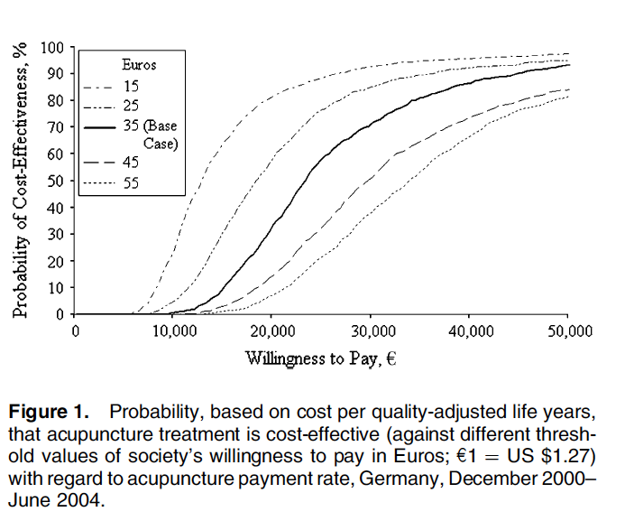
Cost-Effectiveness Acceptability Curve
Source: Witt et al. Am J Epidemiol. 2009;169(5):562-571.

Slide 36
Transferability
Economic evaluations are not generalizable
  Health outcomes are somewhat generalizable because human physiology is often similar across populations
  However, cost structures are rarely similar
  “Operational efficiency may not be relevant to the clinical outcome, but it is critical to the cost outcome.”^{Ellwein, p695}
Best you can hope for is to provide enough information so that a study’s results are transferable
  Usually through modeling
  Report unit costs separate from resources used
Drummond et al, 2005. Int J Technol Assess Health Care. 21(2):165-171.
Drummond et al, 2009. Value Health. 12(4):409-418.
Ellwein et al, 1996. Int J Technol Assess Health Care. 12(4):691-697.

Slide 37

Resources
Also recommended:
Generally acknowledged as the best reference on economic evaluation in healthcare; make sure to get the latest edition:
Drummond MF, Sculpher MJ, Claxton K, Stoddart GL, Torrance GW. Methods for the Economic Evaluation of Health Care Programmes. Fourth Edition ed. Oxford: Oxford University Press, 2015.
Also look for any articles written by the International Society for Pharmacoeconomics and Outcomes Research (ISPOR). Their website has a number of resources for researchers including a series on best practices: http://www.ispor.org/research/research_index.asp.
Quick questions: pherman@rand.org
This book is inexpensive and available on Amazon.

Slide 38
Summary
Economic evaluations provide important information to decision makers
Need to match the perspective (and costs) to the decision maker
Consider building and utilizing models:
  To estimate economic impacts when not measured
  To allow transferability of results across settings
  If you are planning an effectiveness trial, consider also measuring costs

